Slide 1
Testing Multiple Hypotheses for Detecting Targeted Genes in an Experiment Involving MicroRNA
Naveen K. Bansal and Prachi Pradeep
Dept. of Math., Stat., and Comp. Sci.
Marquette University
Milwaukee, WI (USA)
Email: naveen.bansal@mu.edu
and
Hongmei Jiang
Dept. of Statistics
Northwestern University
Evanston, IL (USA)

Slide 2
Outline:
Biology behind microRNA
Statistical Formulation
Bayesian Methodology
Real Data: Some Preliminary Results

Slide 3
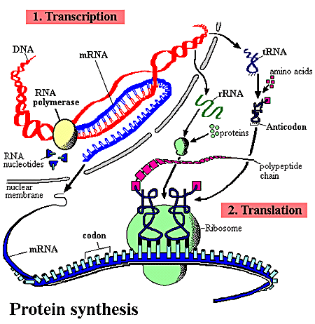
Biology behind microRNA
Transcription, Translation, and Protein Synthesis
Source: http://statwww.epfl.ch/davison/teaching/Microarrays

Slide 4
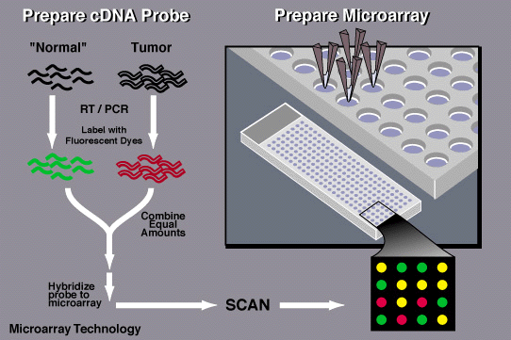
Biology behind microRNA
Microarray Technology
Idea: measure the amount of mRNA to see which genes are being expressed. Measuring protein would be more direct, but is currently harder. Other problem is that some RNAs are not translated.
Source: http://statwww.epfl.ch/davison/teaching/Microarrays

Slide 5
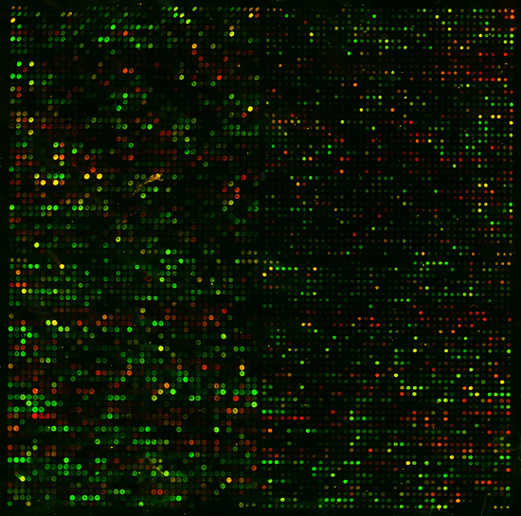
Biology behind microRNA
Yeast genome on a chip

Slide 6
Biology behind microRNA
Back to microRNA:
Past Discoveries:
Many segments of DNA are inactive.
Some can move around the genome of a cell.
For a long time, they were termed as “Junk DNA.”
They do not transcribe, i.e., no RNA molecule is created. However, They can insert into genes, and can trigger chromosome rearrangements.
(McClintock, 1940)
Notes:
Transposable elements (TEs) are type of stretches of DNAs. They can insert into genes, and can trigger chromosome rearrangements.

Slide 7
Biology behind microRNA
Recent Discoveries:
Many transcribed non-coding RNAs have been
identified, some containing short sequence of
nucleotides, and some containing large. They do
not translate.
Transcribed RNAs containing short sequence of nucleotides are called microRNA or miRNA.

Slide 8
Biology behind microRNA
It is believed that some miRNAs play important
roles in regulating mRNA (protein coding genes).
Many research works focus on the regulatory function
of these genes in cancer causing genes.
These miRNA typically binds to mRNAs via base
pairing at target sites of the coding sequence of
mRNA and thus prevent the translation of the
mRNAs.

Slide 9
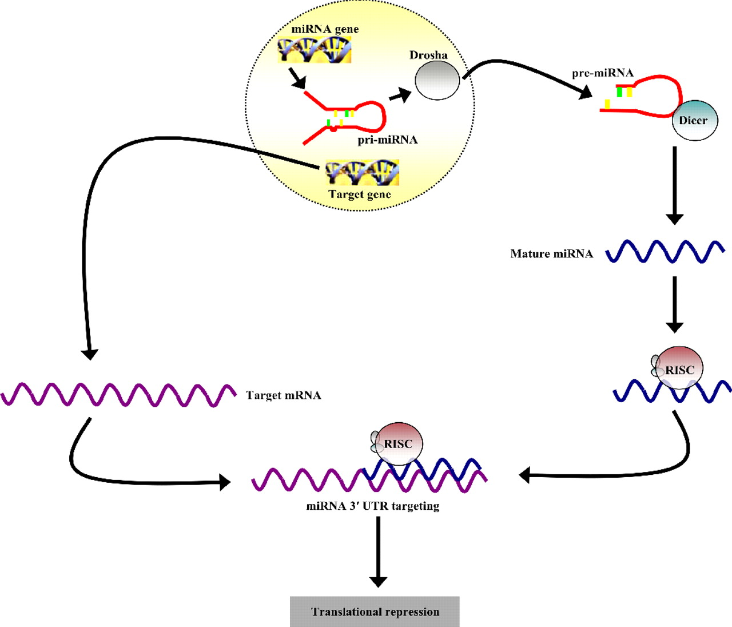
Biology behind microRNA
miRNA genes are transcribed by RNA polymerase II to form primary miRNA (pri-miRNA) molecules. The ribonuclease, Drosha, then cleaves the pri-miRNA to release the pre-miRNA for cytoplasmic export and processing by Dicer. The mature miRNA product associates with the RNA-induced silencing complex for loading onto the 3′ UTR of target mRNAs to mediate translational repression.
Source: PNAS, Sept. 2007

Slide 10
Biology behind microRNA
Theory: Cells carry cancer genes, but miRNAs prevent
their translation?
Hypothesis: Identified miRNAs affect the gene expressions
of protein coding mRNAs.
This can be tested in a lab.
Silence the miRNA , and look for the overexpression of
the targeted genes in a microarray.
Overexpress miRNA, and look for the supression of
the targeted genes in a microarray.

Slide 11
Biology behind microRNA
Experimental identification of microRNA-140 targets by silencing and overexopressing miR-140,
By Nicolas, Pais, and Schwach . RNA, 2008
Experiment-1: miR-140 was silenced. Gene expressions
45,000 mRNAs were recorded.
Experiment-2: miR-140 was overexpressed. Gene
expressions of 45,000 mRNAs were recorded.
Three Replicates

Slide 12
Results of Nicolas et al.(2008)
T-test to determine differentially expressed genes.
Two-different cut-off points for experiment-1 and experiment-2
1236 differentially expressed genes in Experimet-1 and 466 differentially expressed genes in Experiment-2 with 49 common genes

Slide 13
Statistical Formulation
Statistical Modeling:

Slide 14
Statistical Formulation

Slide 15
Bayesian Methodology
Bayesian Decision Theoretic Methodology
Bansal and Miescke (2013): Journal of Multivariate Analysis

Slide 16
Bayesian Methodology
Directional False Discovery rates:
Table
Possible outcomes from hypothesis tests
 | Accept | Accept | Accept | Total
true
true
true
Total

Slide 17
Bayesian Methodology

Slide 18
Bayesian Methodology

Slide 19
Bayesian Methodology

Slide 20
Bayesian Methodology

Slide 21
Bayesian Methodology
Constrained Bayes Rule

Slide 22
Bayesian Methodology
Properties:
1. Selected genes have Bayes optimality under both experiments
2. They are controlled by a false discovery rate in the sense that only a few of them are falsely selected as overexpressed under experiment-1 and falsely selected
as underexpressed under experiment-2.

Slide 23
Bayesian Methodology
Remark: This approach can be applied to a different
loss (Utility) function.

Slide 24
Bayesian Methodology
Prior:

Slide 25
Bayesian Methodology
Prior (Cont.)

Slide 26
Bayesian Methodology

Slide 27
Bayesian Methodology
Estimation of Hyper-parameters:

Slide 28
Bayesian Methodology

Slide 29
Bayesian Methodology

Slide 30
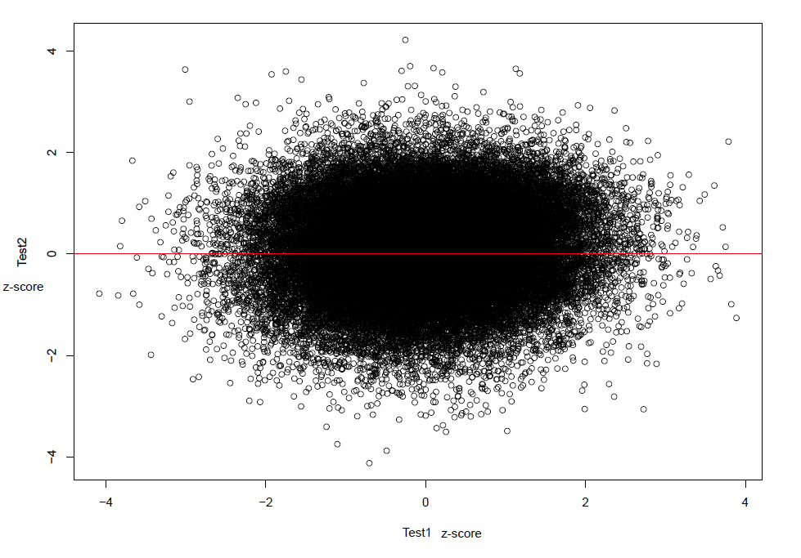
Some Preliminary Results of Nicolas et al. (2008) data

Slide 31
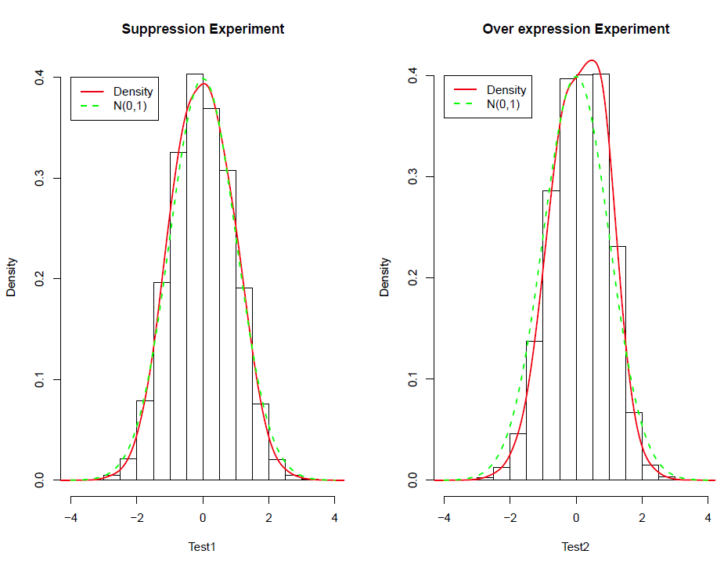

Slide 32
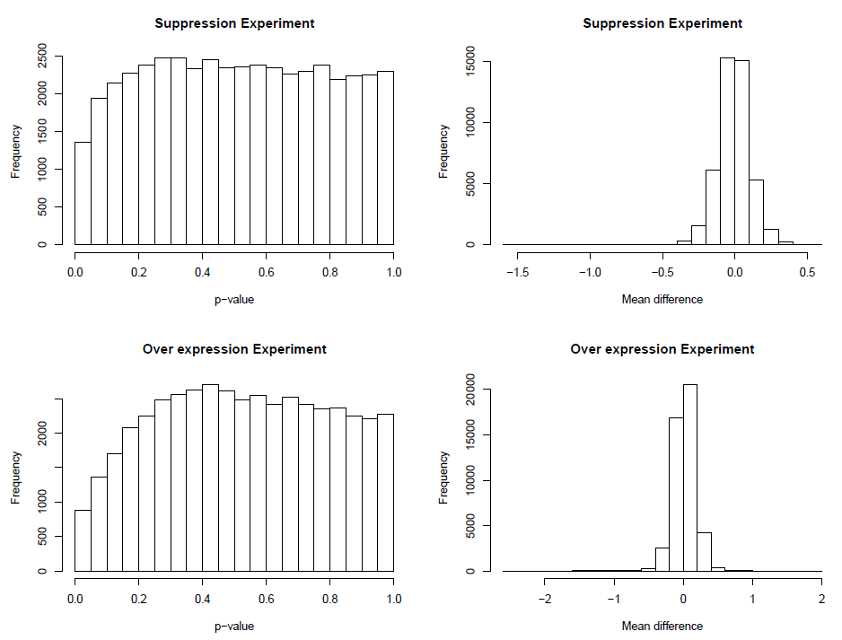

Slide 33
Smallest p-value for experiment-1: 0.0002387974
and
Smallest p-value for experiment-2: 0.0001600851
BH FDR approach fails due to large number of genes
(m= 45,000)
However, we have 50 genes with
P-values < 0.01 in experiment-1
P-values < 0.05 in experiment-2

