Slide 1
Dynamic Bayesian approaches for inferring gene regulatory networks
Brittany Baur
11/11/13

Slide 2
Outline
Introduction
Microarrays and gene expression
GRN inference
Bayesian Framework
Structure Learning
MCMC
Metropolis-Hastings
Informative Priors
Increasing Prediction Accuracy
Summary

Slide 3
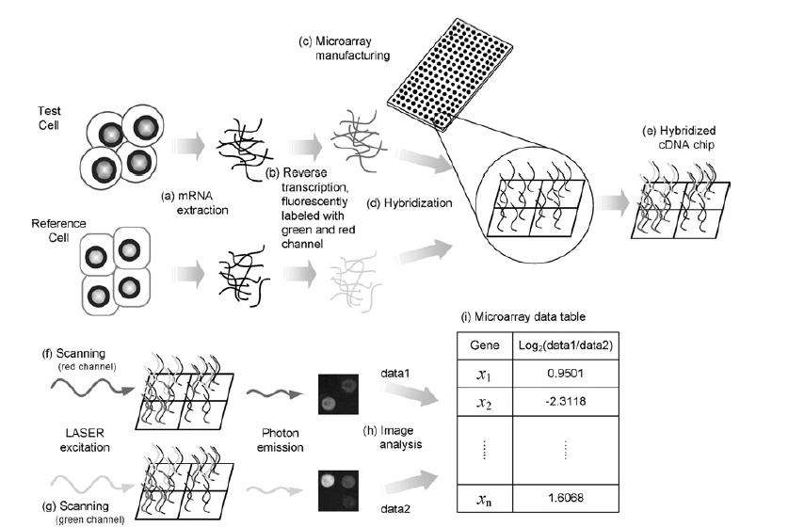
Microarray
Cho et al., 2007

Slide 4
GRN inference
Given gene expression data, the goal is to infer gene regulatory networks.
Nodes are genes and the edges are interactions between the genes.

Slide 5
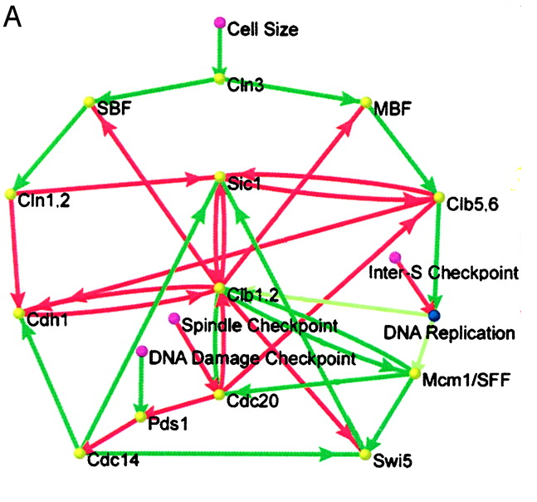
Networks
Li et al, 2004

Slide 6
Networks
Li et al, 2004

Slide 7
Networks
MCM1
TF
SWI5
Li et al, 2004

Slide 8
GRN inference methods
Dynamic Bayesian*
Regression
Differential Equations
Boolean methods
Information theory
Machine Learning

Slide 9
Bayesian Framework
A Bayesian network encodes a probability distribution over a set of random variables
Network structure, S and a set of parameters, q
S is a directed, acyclic graph describing dependencies between random variables
Each random variable is independent of non-descendents, given it’s parents

Slide 10
Dynamic Bayesian Networks
A dynamic Bayesian network extends the Bayesian framework to model stochastic evolution of a set of random variables over time.
T X N interacting random variables

Slide 11
Structure Learning
Goal is to find the most probable network structure from the data D
And the parameters q* that maximize P(q | S*, D)
Applying Bayes’ rule:

Slide 12
Structure Learning
Number of network structures increases exponentially when the number of nodes increases.
Heuristic optimization methods – MCMC or Greedy hill climbing
Data D is sparse → Posterior probability over structures, P(S|D), will be diffuse.
Want to sample networks from posterior

Slide 13
Structure Learning
Direct sampling is not possible – intractable denominator
Resort to MCMC simulation

Slide 14
Structure Learning - MCMC
Given a network structure, propose a new one
Accept/Reject based on Metropolis-Hastings acceptance criterion (Hastings, 1970)

Slide 15
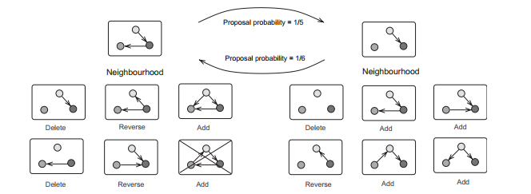
Structure Learning - MCMC
The iteration of such procedure produces a Markov chain that converges to the true distribution
D. Husmeier, 2003

Slide 16
Informative Priors

Slide 17
Informative Priors
Prior has a non-negligible impact on the posterior.
Should be devised to capture known biological features and other types of experimental data.

Slide 18
Informative Priors
TF binding location data provides noisy evidence for the regulatory relationship between a TF and gene
Reported as a p-value

Slide 19
Informative Priors
Define the p-value for location data corresponding to an edge as a random variable (Bernard & Hartemink, 2005)
RV is exponentially distributed if the edge is present in S (Segal et al., 2002)
RV is uniformly distributed if edge is absent from S

Slide 20
Informative Priors
Apply Bayes’ rule to get the probability of an edge after observing a P-value
As λ increases, mass of distribution will become more concentrated at smaller p-values.
As λ decreases, the distribution will spread out and flatten.
Bernard & Hartemink, 2005

Slide 21
Informative Priors
λ acts as a tunable parameter
How low of a p-value we must get before we consider it prior evidence?
Confidence in location data based on belief of noise level
Bernard & Hartemink, 2005

Slide 22
Informative Priors
Bayesian solution for λ
No analytic solution
Precompute numerically for each p-value
Store in a table for later use
Bernard & Hartemink, 2005

Slide 23
Informative priors – integrative genomics approach
Genetic data in a network prior can be used to establish edge directionality (Zhu et al., 2007)
Genes with cis-acting eQTLs are allowed to be parent nodes with genes to trans-acting eQTLs
Are genes driven by the same eQTL?
Infer a relationship based on formal causality test
Reliabilities of the inferred relationships are tested by bootstrapping.

Slide 24
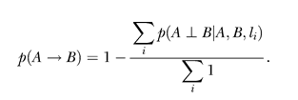
Informative priors – integrative genomics approach
Independent relationship:
Causal relationship:
Zhu et al., 2007

Slide 25
Increasing Prediction Accuracy

Slide 26
Increasing Accuracy
Traditional methods have assumed that the time unit in a time course microarray is the transcriptional time lag.
Limit potential regulators to those that have earlier or simultaneous expression changes to their target genes (Zou & Conzen, 2005)
Use the time difference to estimate a more biologically relevant transcriptional time lag.

Slide 27
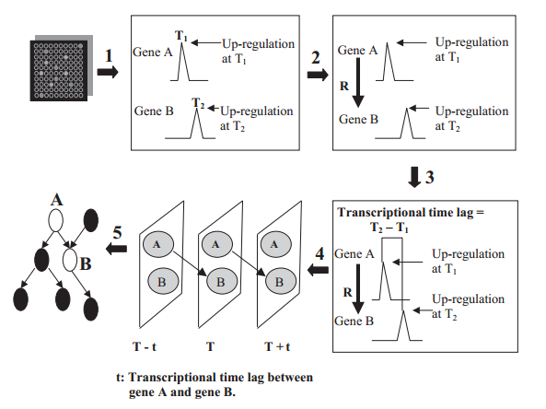
Increasing Accuracy
Zou and Conzen, 2005

Slide 28
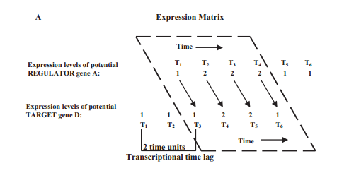
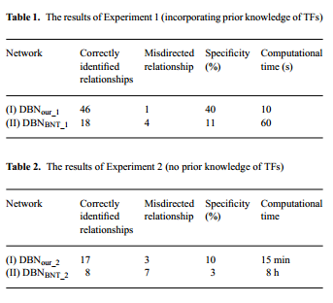
Increasing Accuracy
Zou and Conzen, 2005

Slide 29
Summary
Dynamic Bayesian approach allows the incorporation of multiple data types as prior knowledge with the expression data being central to the marginal likelihood.
Exhaustive search methods are not feasible. Many heuristic search methods over the structures have been implemented.
Aside from informative priors, many other ideas have been explored to improve the prediction accuracy.

Slide 30
References
Bernard A & Hartemink A. Informative structure priors: joint learning of dynamic regulatory networks from multiple types of data. Pacific Symposium on Biocomputing 459-470, 2005.
Hastings, W. Monte Carlo sampling methods using Markov chains and their applications Biometrika 57:97-109, 1970.
Husmeier D. Sensitivity and specificity of inferring genetic regulatory interactions from microarray experiments with dynamic Bayesian networks. Bioinformatics 19(17):2271-2282, 2003.
Segal E, Barash Y, Simon I, Friedman N, Koller D. From promoter sequence to expression: A probabilistic framework. Recomb 263-272, 2002.
Zhu J, Wiener M, Zhang C, Fridman A, Minch E, Lum P, Sachs J, Schadt E. Increasing the power to detect causal associations by combining genotypic and expression data in segregating populations. PLOS Computational Biology 3(4):e69, 2007.
Zou M & Conzen S. A new dynamic Bayesian network approach for identifying gene regulatory networks from time course microarray data. Bioinformatics. 21(1):71-79, 2005.

